Slide 1
New – ASCII Table – enter key
Mr. Neat
Java

Slide 2
Need to detect the “enter” key
The user is done with their attempt to type the answer when they hit the enter key
We need to know how to detect this
The answer is derived from the ASCII Table (beyond the scope of this course, but really important to know)

Slide 3
the “enter” key
The ASCII code is the numerical representation of a character
Each character on the keyboard has a unique value (number)

Slide 4
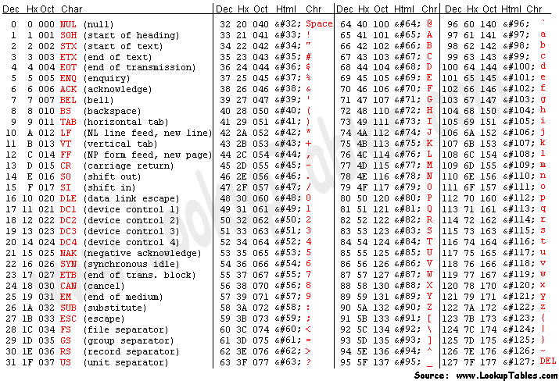
ASCII Table
The ASCII code is the numerical representation of a character
Each character on the keyboard has a unique value (number)
enter
key

Slide 5
Detecting the “enter” key
enter
key
public void keyPress(String s)
{
char done = (char)10;
String temp = Character.toString(done);
String representation
of the enter key

Slide 6
Lab
Your program should display each keystroke from the user horizontally on the canvas
You can decide the spacing
When the user hits the enter key, their total typing attempt should be printed to the command window

